Slide 1
Instructional Efficiency in Asynchronous Online Discussions
Emily Faulconer, Ph.D.
Darryl Chamberlain, Ph.D.
Beverly Wood, Ph.D.
Embry-Riddle Aeronautical University

Slide 2

Asynchronous online course offerings are increasing.
+
“No Significant Difference” in student grades
-
Higher withdrawal rate
Notes:
In 2019 there were over 7.3 million students enrolled in distance education courses at degree-granting institutes of higher education, 3.45 million of these students were enrolled exclusively in online courses. This is an important sector of the undergraduate student population (National Center for Education Statistics, n.d.).

Slide 3
Understanding student persistence in online learning is complex.
Institutional Characteristics
Student Expectations & Satisfaction
Cost/Benefit
Attrition vs. Persistence
Learner Characteristics & Skills
External/Environmental Factors
Engagement
Internal Personal Factors
Psychological Attributes
Before Course
During Course
Notes:
The framework presented here combines key dimensions of student persistence from Tinto’s Student Integration Model, Bandura’s Social Cognitive Theory, and Bean’s Model of Student Departure.
Some of the elements within various dimensions are straightforward for an institution to address, such as instructional design grounded in best practices. Other elements are more challenging for an institution to address, such as the student’s prior online course experience and their external support network. There are many moderating variables for persistence, including demographics such as age and ethnicity.
Understanding these factors in an online course can allow researchers and educators to explore the influence of interventions that address issues such as performance, persistence, or equity.

Slide 4
Cognitive load influences persistence and satisfaction in online courses.
Learning tasks in online courses demand working memory resources – cognitive load.
Intrinsic load: amount of mental processing required to understand the task
task complexity
element interactivity
task environment
Extraneous load: working memory load experienced as learners interact with learning materials
Material presentation (split attention, redundancy, etc.)
Germane load: work required to create a new knowledge schema

Slide 5

Cognitive load influences persistence and satisfaction in online courses.
Cognitive Load
Intrinsic Load
Extraneous Load
Germane Load
Notes:
Learning tasks and activities in a course demand working memory resources to process information – referred to as cognitive load. High cognitive load – cognitive overload - can interfere with creation of new memories and processing of new information. High cognitive load – especially early in the course – is linked to attrition in online courses.
Instructors and course designers can influence intrinsic and extraneous cognitive load through course design and pedagogical methods employed.
Cognitive overload is usually a result of high extraneous and intrinsic load. Cognitive overload has been linked to attrition, lower student satisfaction, and lower student performance in online courses. A recent study reported that cognitive load explains approximately 25% of the variance in student satisfaction with an online course (Bradford, 2011).

Slide 6

Asynchronous online classes often use discussions to establish a learning community.
Idea exchange
Content focus
Critical thinking
Peer feedback
Problem solving
Collaboration
Notes:
The bullet points on this slide present aspects of asynchronous online discussions that are in research literature from 2021. This is an active area of SoTL research.
The community developed through these discussions can be evaluated through the lens of Community of Inquiry, specifically teaching presence, social presence, and cognitive presence.

Slide 7


Learners & instructors project their personality into the community through social presence.
Affective responses
Interactive communication
Cohesive responses
Peer Support Hypothesis
Notes:
Affective responses include expression of emotions, use of paralanguage like emojis, use of humor, and self disclosure through the sharing of personal information.
Examples of interactive communication includes acknowledgement of comments of others, sharing thoughts, expressing agreement, and expressing appreciation. Interactive communication is in response to someone else. This is distinct from cohesive responses where the engagement is aimed at encouraging others to engage the poster. Cohesive responses include group reference through the use of inclusive pronouns like “we”, using phatics and salutations, vocatives, and social sharing of information.
As postulated in the peer support hypothesis, strong peer connections limit isolation in e-learning and therefore may address persistence in online students. It is important to note that, while students do value online courses with strong instructor presence, the influence of social presence on persistence is still debated within online education.

Slide 8

Teaching presence may reduce extraneous load and improve persistence.
}
Design
Direction Social and Cognitive Interactions
Facilitation

Slide 9
Students’ cognitive presence in online courses can be predicted by social & teaching presence.
Triggering event
Puzzlement
Clarification
Exploration
Agreement/Divergence
Information Sharing
Leap to Conclusions
Personal Narration
Opinion
Integration
Building On
Creating Solutions
Justified Hypothesis
Supported Agreement/Divergence
Resolution
Wrap-Up
Thought Experiment
Apply, Test, Defend
Notes:
Even the teaching presence of instructors who are not course designers correlates to learner cognitive presence.
Cognitive presence is the construction of meaning through communication. Typically, students tend to display lower levels of cognitive presence in asynchronous discussions. However, course design and skillful instructor facilitation can promote higher cognitive presence, reaching integration and resolution.

Slide 10

This study was designed as a quantitative descriptive case study.
RQ1: Are student social & cognitive presences and instructor social & teaching presences consistent throughout a course (module-to-module)? Section to section?
RQ2: What factors predominate within each presence?
RQ3: What tasks in asynchronous online discussions influenced cognitive load?
(variables measured, not manipulated or controlled)
Population: Introductory Physics sections Oct 2020 – Jan 2021
Survey data: NASA-TLX
476 Pop, 67 Resp (14% response rate)
LMS data:
final course grade, discussion scores (476 total)
Discussion transcripts (29, 12, 27, 23 = 91 total)
Notes:
The goal of this study was to understand the current conditions for CL and CoI in asynchronous online introductory undergraduate STEM courses.
Raw data was deidentified and reported in aggregate. This study was reviewed by our institutional review board and deemed exempt. Signed informed consent was not required, but study information was presented and a preliminary survey question asked for consent.

Slide 11
Discussion transcripts were coded for community of inquiry presences.
Student Social Presence | Student Cognitive Presence | Instructor Presence
Affective Responses: Emotion, expressions, humor, or personal information. | Triggering Event: Asking a content question or clarifying content. | Facilitating Discourse: Encouraging consensus and student contribution.
Interactive Responses: Responses between individuals. | Exploration: Low-level arguments like (dis)-agreeing without substance, sharing facts, stating content opinions, and content-related stories. | Instructional Design & Organization: Setting expectations, establishing netiquette, and macro-level comments about course and content.
Cohesive Responses: Responses to the class in general or purely social functions. | Integration: High-level arguments like building on a previous statement, (dis)agreement with reasoning, & making conclusions. | Direct Instruction: Responses that focus on student learning of discussion concepts.
 | Resolution: Highest-level arguments like synthesis of information and drawing a conclusion with reasoning.
Notes:
Because the raw number of instances of a presence is skewed by the length of a message (Rourke et al., 1999), results were reported as social presence density (SPD) (Garrison et al., 2000; Hughes et al., 2007; Lowenthal, 2012). Similarly, teaching presence (of instructors) and cognitive presence (of learners) was coded using previously-reported categories (Anderson et al., 2001; Darabi et al., 2010), with results reported as teaching presence density (TPD) and cognitive presence density (CPD). Some learner posts were identified by instructors and researchers as having been plagiarized. Because these posts cannot accurately represent the learner’s social and cognitive presence, they have been removed from the study.

Slide 12

We identified 5 discrete tasks involved in engaging in asynchronous online discussions.
✓
Understanding expectations
✓
Crafting initial post
✓
Reading posts
✓
Creating reply posts
✓
Integrating instructor feedback
Notes:
The instrument was validated by confirmatory factor analysis [under review]. For each of these, participants reported cognitive load associated with mental activity, time pressure, effort, and frustration. This validated model does not include physical ability or perceived success. The instrument allows for dropping of subscales due to their independence. The physical ability subscale was dropped from the model because of the minimal cognitive load anticipated due to physical activity related to asynchronous online discussion engagement. Perceived success was removed in the previous validation of the model.

Slide 13

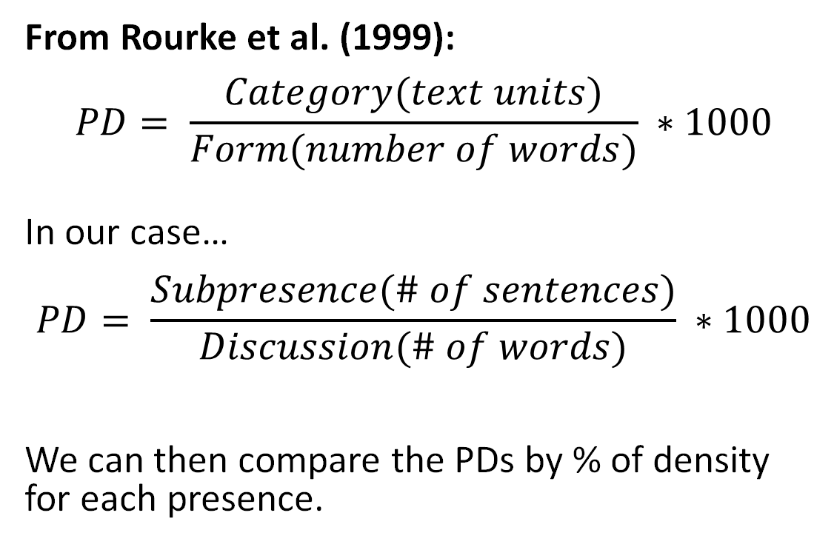
Presence Density acts as a standardization to compare categories without over-representation of verbose responses.
From Rourke et al. (1999):
$$PD= \frac{Category(text units)}{Form(number of words)} ∗1000$$
In our case… $$PD= \frac{Subpresence(\# of sentences)}{Discussion(\# of words)} ∗1000$$
We can then compare the PDs by % of density for each presence.
Notes:
[1] Rourke et al., 1999

Slide 14

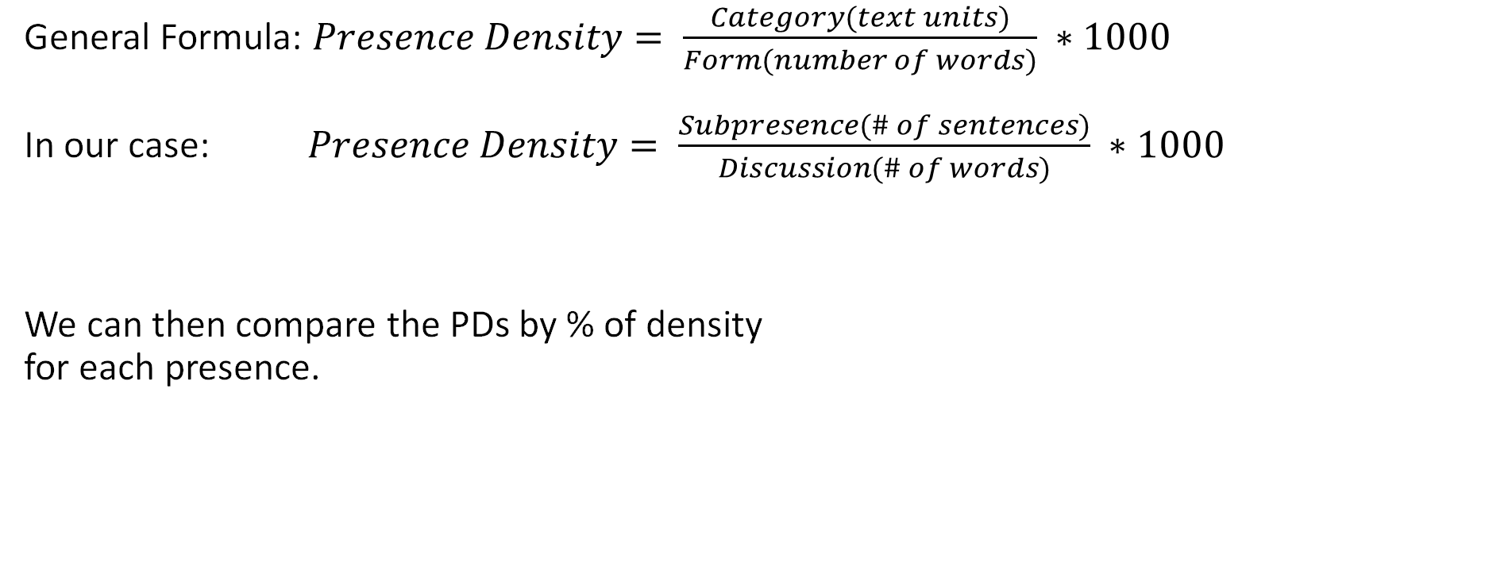
Presence Density acts as a standardization to compare categories without over-representation of verbose responses.
General Formula: $Presence Density= \frac{Category(text units)}{Form(number of words)} ∗1000$
In our case: $Presence Density= \frac{Subpresence(\# of sentences)}{Discussion(\# of words)} ∗1000$
We can then compare the PDs by % of density for each presence.

Slide 15
How do you think Student Social Presence was distributed?
Guess the average percentage of each social presence below.
Affective Responses (Emotion, expressions, humor, or personal information)
Interactive Responses (Responses between individuals)
Cohesive Responses (Responses to the class in general or purely social functions)
To vote, go to www.menti.com and use the code #### #### or QR code below.
Notes:
Some instructors were consistent, some were not. Instructors varied wildly with each other.

Slide 16
RQ1: All modules/cohorts analyzed [Social]?
Notes:
Trends are relatively stable across cohorts. Trends are NOT stable across modules.

Slide 17
How do you think Student Cognitive Presence was distributed?
Guess the average percentage of each social presence below.
Triggering Event (Asking a question)
Exploration (Low-level arguments sharing facts)
Integration (High-level arguments like agreement with reasoning)
Resolution (Highest-level arguments like synthesis)
To vote, go to www.menti.com and use the code #### #### or QR code below.
Notes:
Some instructors were consistent, some were not. Instructors varied wildly with each other.

Slide 18
RQ1: All modules/cohorts analyzed [Cognitive]?
Notes:
Trends are similar across cohorts. Trends are NOT similar across modules.

Slide 19
RQ1: All modules/cohorts analyzed [Instructor]?
Notes:
Some instructors were consistent, some were not. Instructors varied wildly with each other.

Slide 20
RQ2: Predominant Student Social Factors
Natural Expression (24%) Sharing insights and thoughts, including specific advice. “Last week, I've anticipated this application coming and I have a video to share…” “About the example …, reminds me of a physics demonstration that I've done in class.” | Vocatives (23%) Use of names and/or official titles. [name]
Social Sharing (19%) Sharing information such as thoughts, experiences, or personal values, (focus is on thought or story, not content or content-related opinion); introducing topic of discussion. “This weekend I decided to flex my nerd bones and watched the episode of "Star Trek" where Data performed an experiment…” | Expressing Appreciation (16%) Complimenting, expressing appreciation, praise, encouragement. “I enjoyed your discussion piece on ambient pressure…” “That's a pretty good description and example of linear momentum.”

Slide 21
RQ2: Predominant Student Cognitive Factors
Information Sharing (60%) Stating a fact, policy, rule; brainstorming; sharing resources. “Sugar is a solid in it's natural form, until it is added into a cup of boiling hot liquid.” “The transfer of heat is broken down into three methods: conduction, convection, and radiation.” | Personal Narrative (9%) Telling a story or relating an incident (e.g. describing practices at their job), relevant to content. “In my aircraft, the MV-22, we don't really have much of a radar system.” “For us on the V-22, we constantly monitor the power output of the engines because…”
Opinion (9%) Stating a belief, personal view, attitude (related to content) with insufficient evidence to conclude as factual. “In my humble opinion, this Law is the first law for a reason.” “In my perspective, vectors are vital to daily flight operations.” | Clarification (6%) Expressing clarification and restating for clarity. “In other words, speed and magnitude of the aircraft.” “To make a complicated answer short, we don't autorotate, nor do we really glide.”

Slide 22
RQ2: Predominant Instructor Factors
Encouraging (24%) Acknowledge, reinforce, encourage student contribution. “Please see the list below and address the corrections as needed.” “Thank you for your reply.” | Resources (23%) Providing resources to further understanding and support learning. “Here, [formula] is the weight density of the fluid,” “Please, watch this Khan Academy video and comment on it, or ask questions, or answer the questions of your peers.”
Expectation-setting (14%) Establishing parameters and expectations (including feedback outside of content-focus). “I would like to see more details about the information that you can derive from this topic.” “This external sources must be included in the references at the end of your writing.” | Questioning (11%) Questioning content or responses. Which of them are vectors, and which are scalars? Feedback (11%) Confirm student understanding through feedback, offering recommendations (content-related). “CONCEPT EXPRESSED NOT CLEAR: Then you will take that mass and times it by the desired acceleration.”

Slide 23

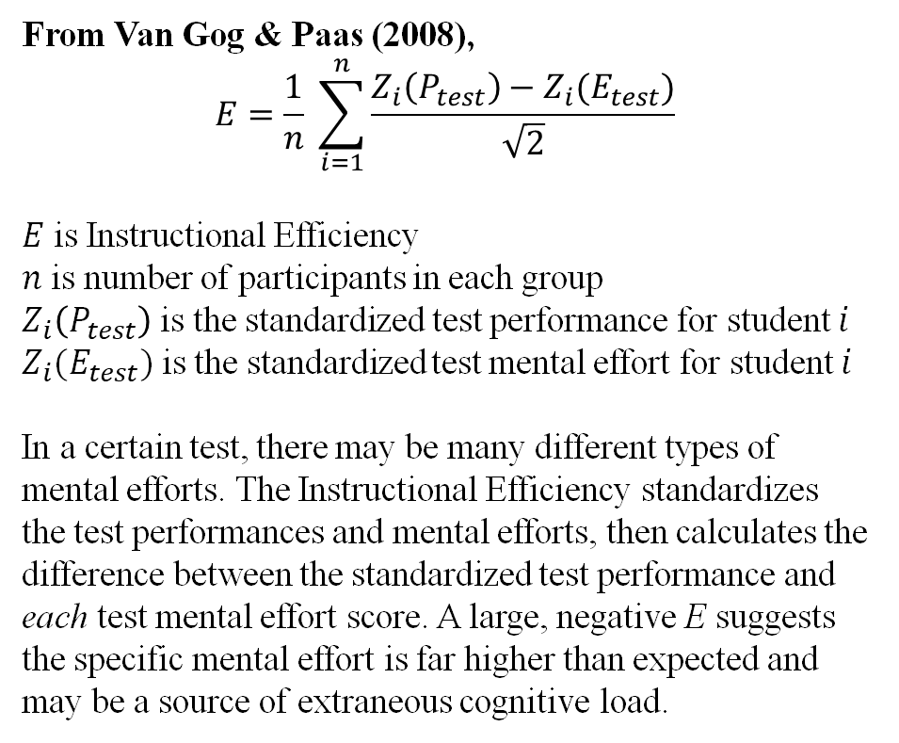
Instructional efficiency is a measure of the effects of instructional conditions on student learning.
From Van Gog & Paas (2008),
$$E=\frac{1}{n} \sum_{i=1}^{n}{\frac{Z_{i}\left(P_{test}\right)−Z_{i}(E_{test})}{\sqrt{2}}}$$
$E$ is Instructional Efficiency
$n$ is number of participants in each group
$Z_{i}\left(P_{test}\right)$ is the standardized test performance for student $i$
$Z_{i}(E_{test})$is the standardized test mental effort for student $i$
In a certain test, there may be many different types of mental efforts. The Instructional Efficiency standardizes the test performances and mental efforts, then calculates the difference between the standardized test performance and each test mental effort score. A large, negative E suggests the specific mental effort is far higher than expected and may be a source of extraneous cognitive load.
Notes:
In our study, we use CL as mental effort and CPD as performance. This is a direct measure of performance and removes the potential of bias and variations in instructor grading.

Slide 24

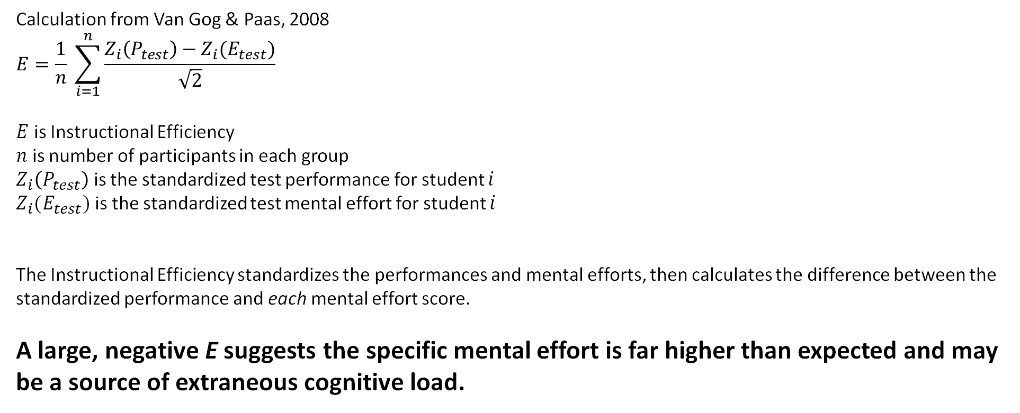
Instructional efficiency is a measure of the effects of instructional conditions on student learning.
Calculation from Van Gog & Paas, 2008
$$E=\frac{1}{n} \sum_{i=1}^{n}{\frac{Z_{i}\left(P_{test}\right)−Z_{i}(E_{test})}{\sqrt{2}}}$$
$E$ is Instructional Efficiency
$n$ is number of participants in each group
$Z_{i}\left(P_{test}\right)$ is the standardized test performance for student $i$
$Z_{i}(E_{test})$is the standardized test mental effort for student $i$
The Instructional Efficiency standardizes the performances and mental efforts, then calculates the difference between the standardized performance and each mental effort score.
A large, negative E suggests the specific mental effort is far higher than expected and may be a source of extraneous cognitive load.
Notes:
In our study, we use CL as mental effort and CPD as performance. This is a direct measure of performance and removes the potential of bias and variations in instructor grading.

Slide 25

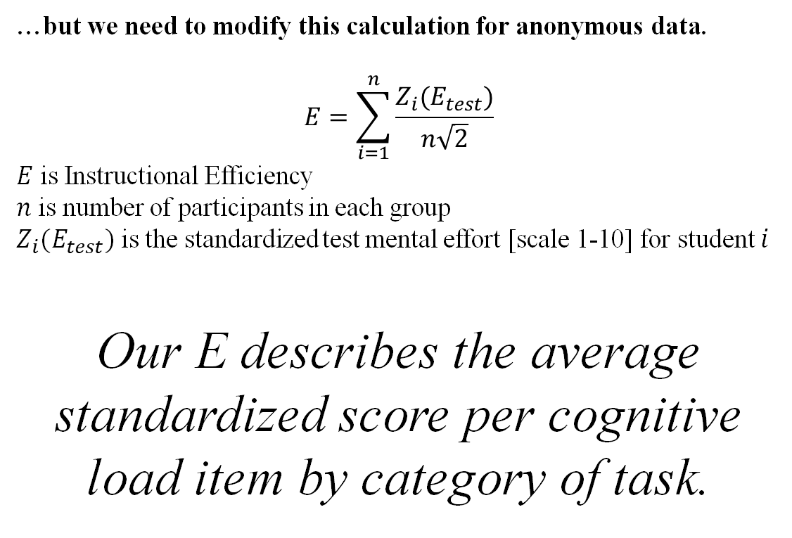
Instructional efficiency is normally measured by participant
…but we need to modify this calculation for anonymous data.
$$E=\sum_{i=1}^{n}{\frac{Z_{i}(E_{test})}{n\sqrt{2}}}$$
$E$ is Instructional Efficiency
$n$ is number of participants in each group
$Z_{i}(E_{test})$is the standardized test mental effort [scale 1-10] for student $i$
Our E describes the average standardized score per cognitive load item by category of task.
Notes:
In our study, we use CL as mental effort and CPD as performance. This is a direct measure of performance and removes the potential of bias and variations in instructor grading.

Slide 26
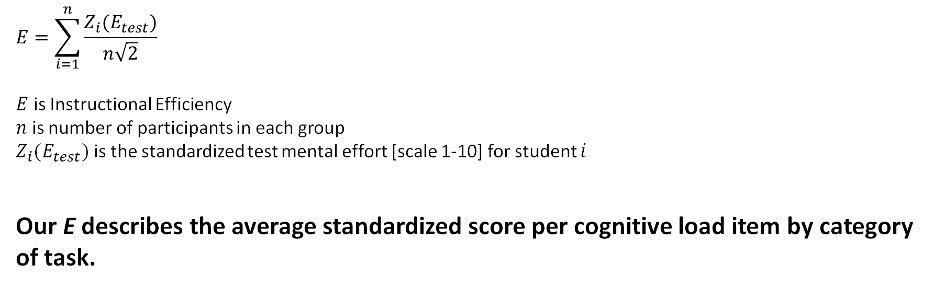
Instructional efficiency is normally measured by participant, but we modified the calculation for anonymous data.
$$E=\sum_{i=1}^{n}{\frac{Z_{i}(E_{test})}{n\sqrt{2}}}$$
$E$ is Instructional Efficiency
$n$ is number of participants in each group
$Z_{i}(E_{test})$is the standardized test mental effort [scale 1-10] for student $i$
Our E describes the average standardized score per cognitive load item by category of task.
Notes:
In our study, we use CL as mental effort and CPD as performance. This is a direct measure of performance and removes the potential of bias and variations in instructor grading.

Slide 27
Try to rank the discrete tasks from most cognitive load to least cognitive load.
✓
Understanding expectations
To vote, go to www.menti.com and use the code #### #### or QR code below.
✓
Crafting initial post
✓
Reading posts
✓
Creating reply posts
✓
Integrating instructor feedback

Slide 28
Results
A positive average standardized rating scaled for error suggests the extraneous cognitive load is higher for this item compared to others.
Notes:
What factors contribute to the highest cognitive load for each task? Compare to previous study.

Slide 29

In Review …
RQ1: Are student social presences, student cognitive presences, and instructor presences in modules and cohorts consistent throughout a course?
Student presences are NOT consistent throughout a course but ARE fairly consistent across cohorts.
Instructor presences are NOT consistent.
RQ2: What factors predominate within each presence?
Student Social: NE (24%), V (23%), SS (19%), EAP (16%)
Student Cognitive: IS (60%), PN (9%), OP (9%), CL (6%)
Teaching: ENC (34%), RS (15%), ES (14%), Q (11%), F (11%)
RQ3: What tasks in asynchronous online discussions influenced cognitive load?
Crafting your initial discussion post
Understanding what is expected
Notes:
Many asynchronous online courses implement an online discussion to promote peer interactivity, nurture communication, and to develop a sense of community. This community can be evaluated through the lens of Community of Inquiry, specifically teaching presence, social presence, and cognitive presence (deNoyelles et al., 2014).

Slide 30

As with any study, there are limitations.
Nonresponse error
Voluntary, un-incentivized survey
Low response rate
Time limitations for data collection limited scope

Slide 31
Planned Intervention: Support Community of Inquiry in asynchronous discussions while mitigating impacts to cognitive load.
“Traditional” Online Discussion
Variables Measured
Social Presence
Teaching Presence
Cognitive Presence
Cognitive Load
Demographics (moderating)
Persistence
Learner in Asynchronous Learning Environment
Performance
CoI-CL Model for Online Discussions
Redesigned prompts
Redesigned rubrics
Faculty professional development
Perspectives
Notes:
The research consistently suggests that cognitive load is an important criteria in designing high-quality online courses (Bradford, 2011; Caskurlu et al., 2021). This study presented a survey of existing CoI and CL conditions in an asynchronous online discussion. For the planned intervention, course designers will address elements of cognitive load when developing online course templates, including design of instructions, rubrics, and other course materials.
While the level of control over course materials (and thus cognitive load) may be limited for instructors based on institutional policy (e.g. using course templates, centralizing course edits through an instructional design team, etc.), instructors can directly influence student persistence in online STEM courses through pedagogical methods employed (Lou et al., 2006). Instructors teaching the course will be provided a short, targeted professional development aimed at promoting their teaching and social presence and promoting strong student social and cognitive presence.
By using instructional efficiency measures, we can determine the efficacy of these interventions.

Slide 32



Cognitive load mitigation strategies & community of inquiry framework are not discipline-specific.
Notes:
Regardless of discipline, careful course design can strengthen the Community of Inquiry presences while mitigating impacts to cognitive load, thus promoting persistence, performance, satisfaction.

Slide 33

Questions?
faulcone@erau.edu
chambd17@erau.edu
woodb14@erau.edu

Slide 34
